Slide 1

Levels of Inquiry Model of Science Teaching: The Pendulum Learning Sequence
Dr. Carl J. Wenning
Physics Department
Illinois State University
Normal, Illinois USA

Slide 2
Levels of Inquiry Method of Science Teaching
Discovery Learning | Interactive Demonstration | Inquiry Lesson | Inquiry Labs | Real-world Application | Hypothetical Explanation
Each level of inquiry has associated with it different intellectual process skills. For example,
  Discovery learning – developing concepts
  Interactive demonstration – predicting and testing
  Inquiry lesson – designing a controlled experiment
  Inquiry labs – collecting and analyzing data
  Real-world application – solving authentic problems
  Hypothetical explanation – developing testable explanations

Slide 3
Level 1: Discovery Learning
Students reflect on their mental models of pendulums by discussing various examples they have encountered.
Students “play” with a pendulum without aid of time or distance measuring devices in order to determine the easily identifiable aspects of the system that can be directly measured. Terms are applied to new concepts such as length, period, amplitude, and mass.
The concept of the simple pendulum is distinguished from that of the physical pendulum by comparing a swinging ball on a 1m string with a meter stick.

Slide 4
Level 2: Interactive Demonstration
The teacher sets up a simple pendulum with a length of 20cm and demonstrates its motion and period reviewing concepts developed during discovery learning.
The teacher asks, “What would happen if I would halve/double the length of the pendulum?” Students predict, write down their prediction, and then observe the result.
The teacher asks, “What would happen if I would quarter/quadruple the length of the pendulum?” Students predict, write down their prediction, and then observe the result. “Do you see a relationship here?”

Slide 5
Level 3: Inquiry Lesson
Students participate as instructor leads a lesson about the simple pendulum using a “think aloud” protocol.
Students predict which factors influence the period of a simple pendulum, and suggest how they might affect it.
Students identify relationships between all significant factors and period of the simple pendulum.
  P is a function of length.
  P is slightly dependent upon amplitude.
  P is not a function of mass.

Slide 6
Level 4: Inquiry Lab
Length and period data are collected and graphed using a controlled experiment (amplitude is held constant).
Students graph data and determine that period is proportional to the square root of pendulum length.
Extension: Students test different amplitudes to determine the limitation of the accuracy of the discovered relationship relationship, P = (2.006s/m^{½})l^{½}
Comparing experimental values of period for various amplitudes with predicted values from small angle formula, students determine at what angle (amplitude) the predicted period diverges from the actual period by more than 5%.

Slide 7
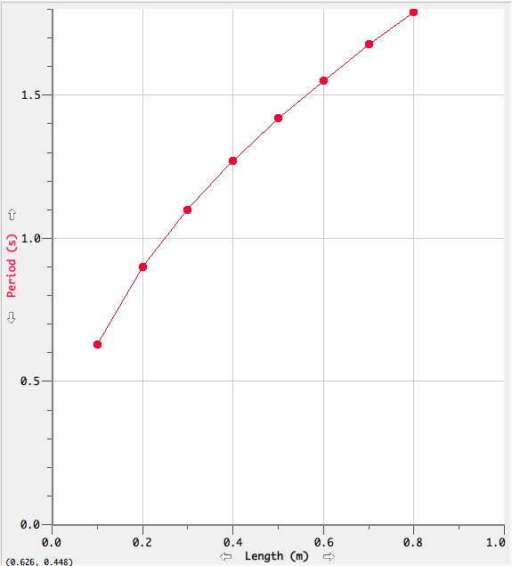
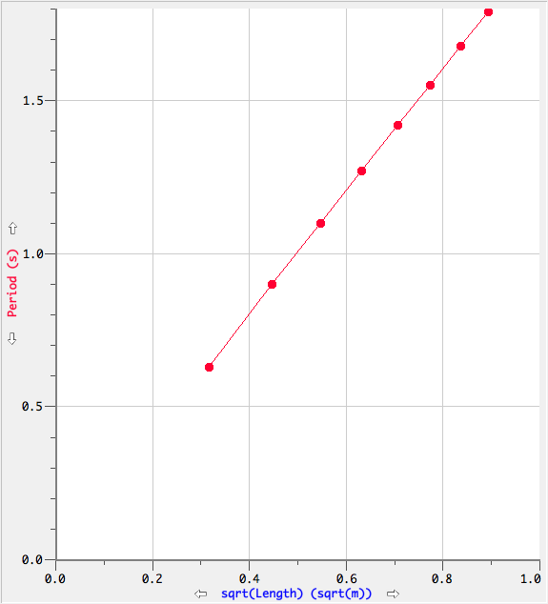
Graphical Analysis Results
Initial Graph
Linearized Graph

Slide 8
Level 5: Real-world Application
Students use a simple pendulum and the theoretical relationship, , to accurately determine the local value of the acceleration due to gravity, g.
Extension: Students perform error analysis by seeing how errors in period, P, and length, l, of the pendulum propagate to g. That is,
Δg = g(Δl/l+2ΔP/P)
See Error Propagation in the ISU Physics Teacher Education advanced Student Laboratory Handbook.

Slide 9
Level 6: Hypothetical Explanation
Students “extract” the value of g from the discovered proportionality constant, 2.006s/m^{½}, using dimensional analysis.
The remaining constant, 6.283, turn out to be ~2π.
See ISU’s Student Laboratory Handbook at http://www.phy.ilstu.edu/pte/302content/student_lab_hdbk/slh.html - See Reconciling Experimental with Theoretical Relationships

Slide 10
To learn more about the Levels of Inquiry Method of Science Teaching
Levels of inquiry: Hierarchies of pedagogical practices and inquiry processes. Journal of Physics Teacher Education Online, 2(3), February 2005, pp. 3-11.
Levels of inquiry: Using inquiry spectrum learning sequences to teach science. Journal of Physics Teacher Education Online, 5(4), Summer 2010, pp 11-19.
The Levels of Inquiry Model of Science Teaching. Journal of Physics Teacher Education Online, 6(2), Summer 2011, 9-16
Sample learning sequences based on the Levels of Inquiry Model of Science Teaching including Appendix (with Manzoor Ali Khan). Journal of Physics Teacher Education Online, 6(2), Summer 2011, 17-30.

